Slide 1
5G WIRELESS NETWORKS
Dr. Cenk M. Yetis and Assoc. Prof. Pontus Giselsson
Automatic Control Department
Lund University
https://tinyurl.com/inspirationalcoffee
Inspirational Coffee
December 13rd, 2020
Notes:
Today, I will talk about 2 elements in 5G networks, beam selection and channel estimation
Beam selection is also about channel estimation, we will see that in the next slides
This is the second version of the slides. I uploaded this version on Dropbox as well
In this version, I tailored the talk even more for the Control department to cover the fundamental concepts
I hope you will find the slides interesting
So, I cannot cover all the slides today
So, for those who are interested further, you can check this link on Monday. There, you will find a video of me going through the slides that I have not covered today
Today, we might have guest students (of Prof. Bernhardsson) from the electronics department

Slide 2
CONTENTS
5G Wireless networks…………………………………………………………………… 1
Contents …………………………………………………………………………………… 2
PART – I – Overviews
MIMO channel …………………………………………………………………………… 5
Training phase ………………….. ……………………………………………………… 6
Beam training …… ……………………..……………………………………………… 8
Channel training …… ……………………..…………………………………………… 9
mmWave … …… …… ……………………..…………………………………………… 10
5G conspiracies … … ……………………..…………………………………………… 17
Notes:
The talk is composed of 3 parts
Part I is the basics, which will take up most of the time in this talk

Slide 3
CONTENTS
PART - II
WASP-Beam training …………..……………………………………………………… 18
Cellular network vs. cell-free network …………..……………………………… 19
Challenges ………………………………………………………………………………… 20
Multi-Label problems………………………………………………………………….. 21
Numerical results ……………………………………………………………………….. 24
Notes:
Part II is about our beam selection paper which I will go through briefly

Slide 4
CONTENTS
PART - III
WASP-Channel estimation…………………………………………………………….. 21
Acquisition of channel state information …………………………………………. 22
Compressed sensing based … ………………………………………………………… 23
Sparse channel estimation …………………………………………………………….. 24
Compressed sensing … … … ………………………………………………………… .. 25
Channel training … …………………………………………………………………….. 27
Compressed sensing recovery ……………………………………………………….. 29
Orthogonal matching pursuit (OMP) ………………………………………………… 30
Iterative algorithms-ISTA and AMP ………………………………………………….. 32
Approximate message passing (AMP) ……………………………………………….. 33
Application of AMP to Bayesian Inference Framework …………………………..34
Numerical results …………………………………………………………………………..36
References …………………………………………………………………………………….37
Notes:
Part III is about channel estimation. I will not have time to go through this section unfortunately
As I said, you can check the link on Monday
As a future note, I plan to prepare one more talk about only the message passing algorithms. So, I will record again or let you know the Zoom link when the talk is available. I will email about this to the department

Slide 5
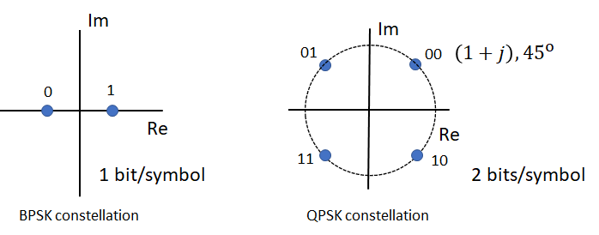
MIMO CHANNEL
$y=Hx+n$
$$y∈ℂ^{M},received signal$$
$H∈ℂ^{M×N},$ $channel matrix$. Different statistical properties based on the technology
$$x∈ℂ^{N},transmitted signal$$
$$n∈ℂ^{N},noise$$
$$x=Us$$
$s∈ℂ^{d}$ (Transmitted symbols)
$U∈ℂ^{M×d}$ (Transmit beamforming matrix)
$$U=\left[\begin{matrix}u_{1} & … & u_{d}\end{matrix}\right]$$
$u_{i}$: Transmit beamforming vector for the stream i
to be transmitted from N antennas
$$N=3$$
$$h_{11}$$
$$M=2$$
$$h_{21}$$
$$h_{12}$$
$$h_{22}$$
$$h_{13}$$
Transmitted symbols:
$$h_{23}$$
$$H=\left[\begin{matrix}h_{11} & h_{12} & h_{13} \\ h_{21} & h_{22} & h_{23}\end{matrix}\right]$$
Multiple-Input Multiple-Output (MIMO)
Channel
Notes:
This slide is from the last year’s presentation as a recap. This is the equation that we are interested in
y is the received signal vector …
There is a random complex number between each pair of antennas. We stack these numbers in a matrix called channel matrix
The transmitted signal x is U times s. s is the vector of transmitted symbols which we eventually want to decode (or in other words estimate) at the receiver. These symbols can be like 1s and 0s as in computer systems, or 1+, 1-js if we use QPSK constellation
The U matrix is called beamforming matrix. Each of its column affects a symbol, the 1st column affects the 1st symbol, the 2nd…, and so on.
By designing the U matrix, you form a beam to transmit a symbol on the beam, you can say so. Sometimes the word stream is used instead of symbol because we keep sending/streaming the symbols
The U matrix must be designed during the training phase which is right before the data transmission phase

Slide 6
TRAINING PHASE
$y=Hx+n$
$x=Us$
A training phase exists before the data transmission phase
$U$ must be designed during the training phase
Design $U$ based on $f\left(H\right)$ (a function of $H$). In general, this is called channel state information at the transmitter (CSIT)
e.g., Channel estimation (channel training):
Step 1) Estimate the channel matrix
Step 2) Design $U$ based on $\hat{H}$ (imperfect CSIT)
Design $U$ based on $f\left(.\right)$ (a function of something else). No CSIT
e.g., Beam selection (beam training) (a greedy approach):
Step 1) Create a set of beamforming options, $𝓤=\left\{u_{1},u_{2},…u_{B}\right\}$ where $B$ is
the number of beamforming options
Step 2) Select the columns (beamforming vectors) of $U$ from the set $𝓤$
Notes:
So, we must have a training phase before the data transmission phase
$U$ must be designed during the training phase
The U matrix can be designed based on a function of the channel matrix. In general, …
Or, the U matrix can be designed based on something else, not based on the channel. This is called no CSIT in general
For the first option, for instance, you can do channel estimation
Then you optimize the U matrix based on the estimated channel values, which can be called imperfect CSIT
Sometimes, you can assume you know the exact H, which is called perfect CSIT, which is not a realistic assumption of course
For the second option, for instance, you can do beam selection. Here, a beamforming vector is shortly called as a beam
It can be also called beam training. As you know, selection algorithms are usually called greedy approaches
In this approach, first, you create a set of beamforming options based on some reasoning
Then you select each of your beamforming vectors (beams) out of this set
In this option, clearly, you are avoiding to do a channel estimation

Slide 7
TRAINING PHASE
Before the data transmission phase, the training phase is needed
During the training and data transmission phases, the assumption is that
the channel matrix H stays constant
Training phase
Channel training (channel estimation). Conventional approach
Beam training (beam selection)
Introduced and preferred for 5G mmWave communications where we have many antennas
Channel estimation is avoided since it can be challenging with many antennas in terms of
Computation
Hardware
A trivial linear beam selection algorithm is observed to provide satisfactory results with low complexity and simple hardware
Training phase
Data transmission phase
Training phase
Data transmission phase
…
$$H$$
$$H^{′}$$
Notes:
To repeat, before the data transmission phase, we need a training phase to design the U matrix with or without CSIT
Here the assumption is that, during the …, does not change
For both training options, either you do channel or beam training, the training and data transmission phases must be cyclic
That is, each time the channel changes, you need to do a training before the data transmission phase
So, again, for the training phase, we can prefer the channel training option which is a conventional approach
Or, we can choose the beam training approach which is introduced and preferred for 5G networks where we have many antennas
Here, channel estimation is avoided because channel estimation can be challenging with many antennas in terms of
computational complexity and hardware
In fact, a proper beam selection can also be computationally complex and costly in hardware since the B number, the number of beam options to select from can become a large number easily
However, a simple and trivial linear beam selection algorithm is observed to …
So, currently, beam selection is selected in the 5G standards

Slide 8
BEAM TRAINING
Beam selection (linear)
Assume we have $B=2$ predefined beams $𝓤=\left\{u_{1},u_{2}\right\}$
Selection Metric Option-1
Direct link power
and so on…
Continue with access point (AP) 3 for user 1
Redo with all APs for user 2
$$u_{2}$$
$$u_{1}$$
$$U_{1}$$
$$U_{2}$$
$$u_{1}$$
$$u_{2}$$
$$t=1$$
$$t=KLB$$
$$t=4$$
$$t=3$$
$$t=2$$
$$U_{3}$$
$$L=3$$
$$K=2$$
Notes:
Let’s have a look at the linear beam approach, which is very straightforward
Here is a case where we have 3 transmitters, and 2 receivers.
We assume we have only two beam options to select from for simplicity
First, we can start with receiver-1 (sometimes it is called user-1)
While all other APs are silent, AP-1 tests each of the beams to see which beam achieves the best performance
Here, your performance metric is the received signal power, which can be called the direct link power
Basically, you select the beam which is more directed towards the user
Then while all other APs are silent, this time AP-2 tests the beam options …
Each AP selects a beam for user-1, the algorithm continues with user-2
This is the trivial algorithm accepted in 5G standards

Slide 9
CHANNEL TRAINING
Channel estimation
Assume downlink (DL) data transmission, acquisition of channel state information at the transmitter (CSIT) options are
Time division duplexing (TDD)
Frequency division duplexing (TDD)
$y=Hp+n$, $p:$ pilot signal (pilot symbols) instead of $x=Us$
frequency
frequency
$$f_{1}$$
$$f_{1}$$
$$f_{1}$$
$$f_{1}$$
$$f_{1}$$
$$f_{2}$$
$$f_{2}$$
$$t_{1}$$
$$t_{2}$$
time
$$t_{1}$$
time
Notes:
I will not get into the details of channel estimation
Let me mention this point briefly
Since now your unknown is the H matrix because you want to estimate the H matrix now, you do not transmit x anymore but transmit p, which stands for the pilot signal
Pilot symbols are known by both transmitters and receivers so that your unknown is H this time, so that you can estimate H or in other words, you can do channel estimation

Slide 10
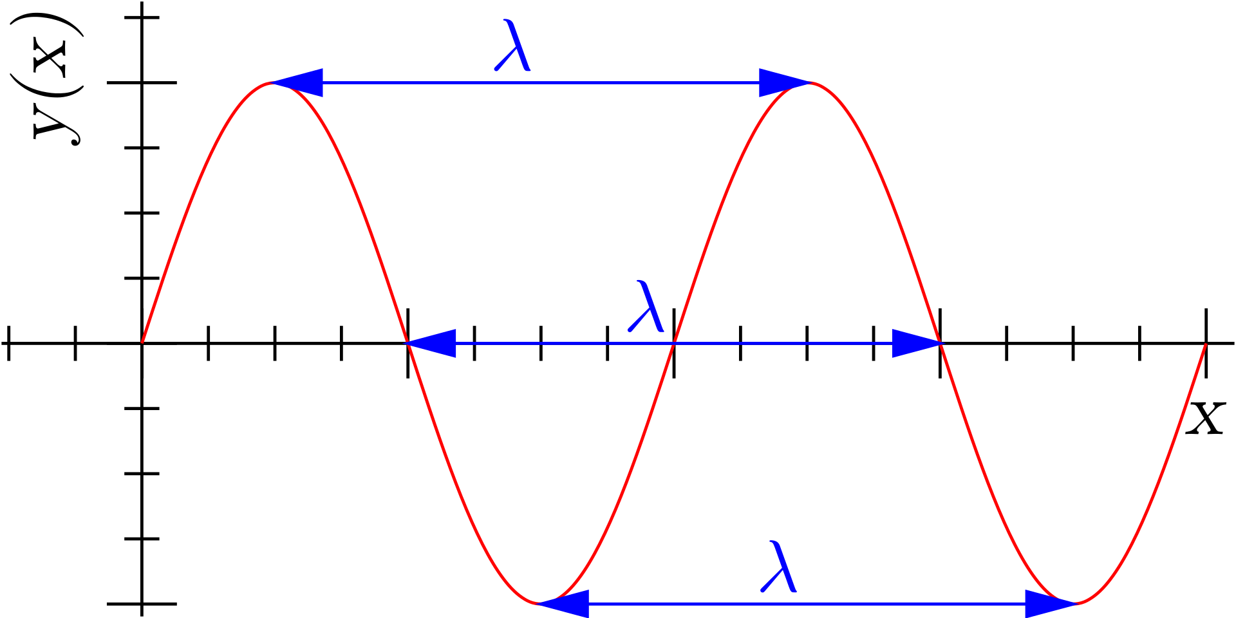
mmWave OVERVIEW
Wavelength formula:
$λ=c/f$ (spatial period)
$λ$: Wavelength (m)
$f$: Frequency (Hz)
$c$: Speed of light (m/s)
E.g.,
For a signal with $1$ GHz
$λ=3×{10}^{8}/1×{10}^{9}m$
$$={3×10}^{−1} m =\text{300 }\text{mm}$$
$\text{=}{\text{3}×10}^{5}µm$
For a signal with $30$ GHz
$λ=3×{10}^{8}/30×{10}^{9}m$
$={10}^{−2} m =\text{10 }\text{mm}$
$\text{=}{10}^{4}µm$
4G: microwave signals
5G: microwave signals + mmWave signals
©
Notes:
In 5G, we will have mmWave signals in addition to microwave signals that we currently have in 4G
What is a microwave or mmWave signal?
The wavelength of your wave (signal) is given as, lambda=… It is a period in spatial domain (space domain) in meters
Like the periods of sinusoidal waves we are used to see in the time domain. The only difference is this is in the space (spatial) domain because we have speed parameter here, c. If there is no c, this will be the time domain, and this will be the period of the signal in seconds
For 3/4G microwave frequencies, you can talk about 800 MHz, 1.8 GHz, and 2.1 GHz frequencies for instance
For 5G mmWave frequencies, you can talk about 30 GHz ranges
So when you look at the wavelengths of these signals, they are both in the order of 1 mm, not in the order of 1 micrometer
But for some reason, you can Google this, people ask the same question also, if the wavelength is larger than 10 mm it is called microwave (Perhaps one reason is micro in Greek language might mean small, but I am not sure)
And if the wavelength is between 10 mm and 1 mm, it is called mmWave

Slide 11
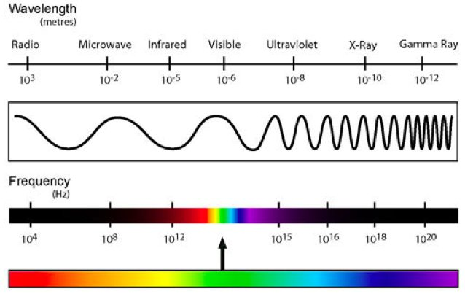
mmWave OVERVIEW
$$λ=c\left(1/f\right)$$
$$x=vt$$
$λ=c/f$
$f↑, then λ↓$
$$λ$$
© Efficient Radar Forward Operator for Operational Data Assimilation within the COSMO-mode by Zeng
Notes:
As seen in this figure, and as we know from the wavelength formula, as the frequency increases, the wavelength of the signal decreases
What does this mean?
You can say that the frequency is approximately equal to inverse of time t.
Then the wavelength equation is like a distance formula traveled by a car which is given by x=vt, as you know
Then the wavelength is the distance a signal can travel in a full cycle
Therefore, when the frequency is higher, the wavelength of your signal is smaller which means that your signal can travel less distance in space (or spatial domain)

Slide 12
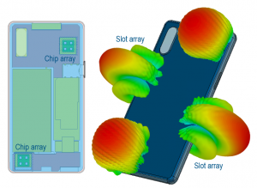
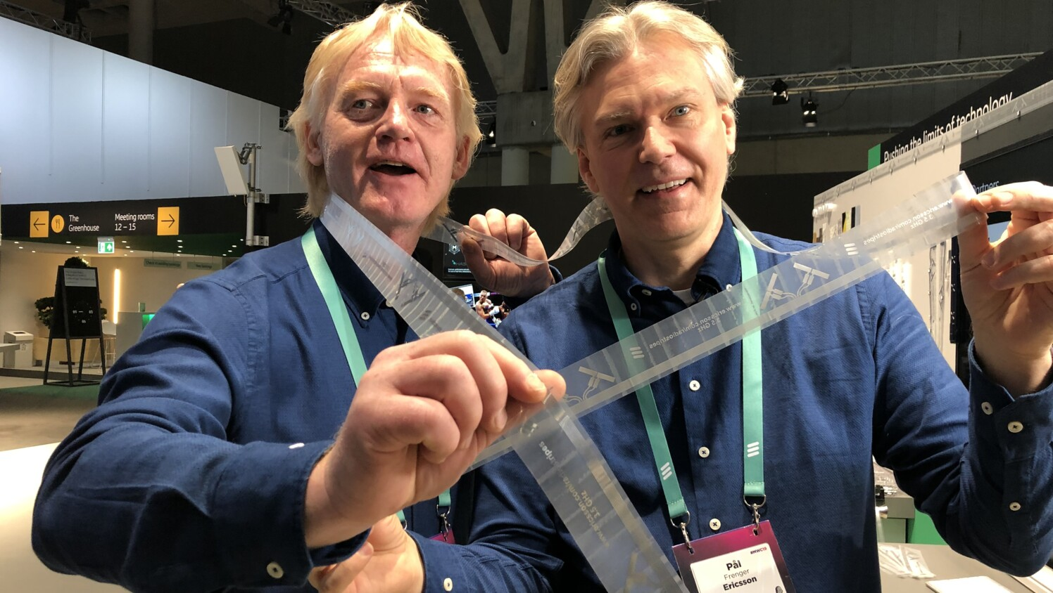
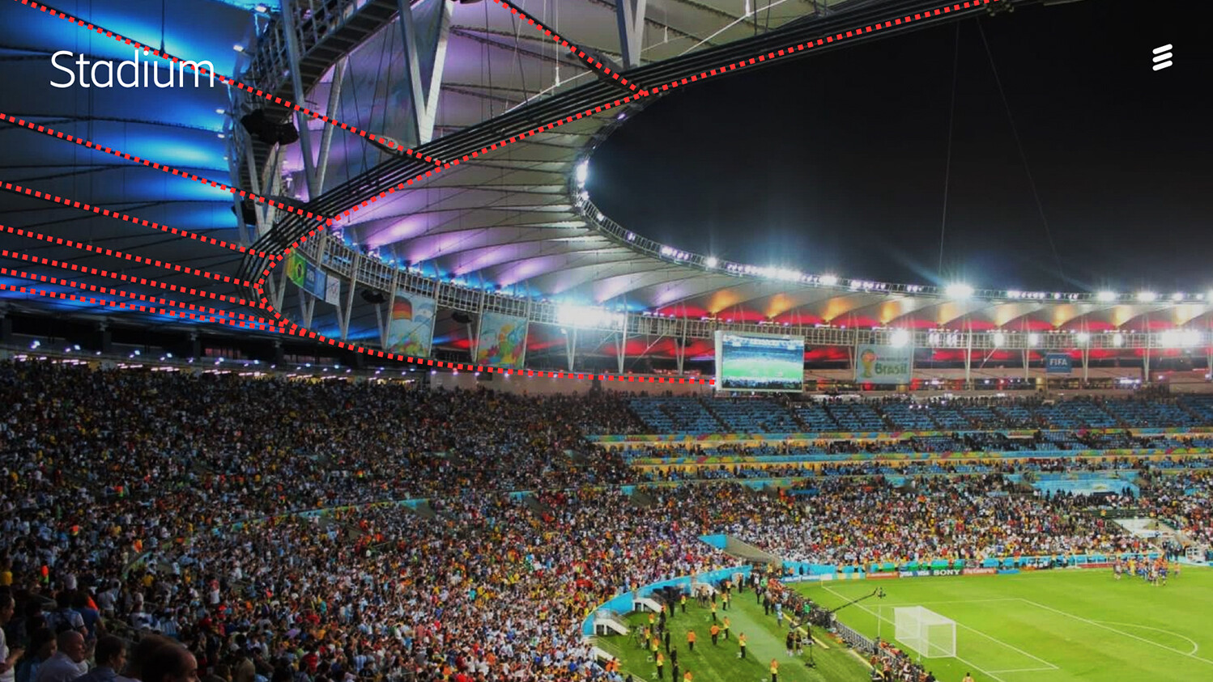
mmWave OVERVIEW
$$λ=c\left(1/f\right)$$
$$x=vt$$
$f↑, then λ↓$
Some disadvantages
The wave can travel less distance
More transmit power at the transmitter is needed to travel the same distance
More expensive and less stable equipment
Some advantages
The spectrum is less crowded
The bandwidth is wider
More antennas can be packed
Antenna length $∝1/f$
Distance between the two antennas $∝1/f$
Radio stripes
©
©
Notes:
So, this is a disadvantage, the signal can travel less distance
Or, to travel the same distance at a higher frequency, you need to send the signal from the transmitter with a higher power. So this is also a disadvantage
Also, equipment can be more costly and less stable at higher frequencies
So what is the advantage of higher frequencies then?
At higher frequencies, the spectrum is less crowded and the bandwidth ... I will talk about these two new terms in the next slide
Another advantage is that more antennas can be packed in the same area because the antenna length and the distance that must be between the two antennas are inversely proportional with f
Here you see a phone that can have 4 antennas at the edges
In fact, in future, it will be very different from today. Ericsson plans to have radio stripes. This is a long plastic like looking antenna which can be placed along the walls at a stadium, university etc.
The cellular BSs will be also different, I will show them later

Slide 13
mmWave OVERVIEW
E.g., voice signal
Spectrum: The range of frequencies a signal has vs. the amplitude
Bandwidth: The difference between the maximum and minimum frequency values
©
Center frequency
Bandwidth
Notes:
Let’s see the meanings of spectrum and bandwidth
Our voice is also a signal, so let’s explain these terms on a voice signal
Spectrum: …
Bandwidth: …The max-min frequency difference
So the spectrum is the whole figure whereas BW is only this distance
In a spectrum, you have the amplitude information per frequency, BW, and the center frequency of your signal

Slide 14
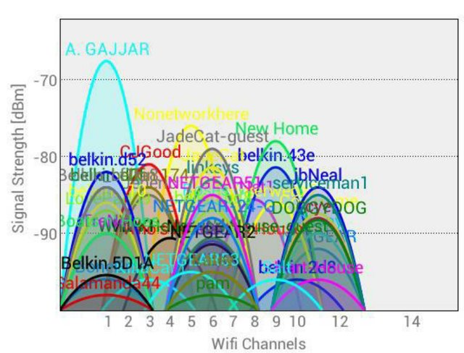
mmWave OVERVIEW
At lower frequencies
The spectrum is more crowded
Bandwidths are narrower
Examples
WLAN at 2.4 GHz and 5 GHz (center frequency)
Bluetooth at 2.45 GHz (Microwave oven-noise)
DECT phones at 1.9 GHz
© Viability of business models for multi-operator Wi-Fi coordination platforms by Dittrich and Hartog
Notes:
At lower frequencies, the spectrum is congested. Therefore, you cannot have contiguous wide bandwidths at lower frequencies
As examples, WLANs operate at …
The handset and the main part of DECT phones talk to each other
The reason we have now 5 GHz as an additional option to 2.4 GHz for our WiFi routers at home is same because WiFi signals at 2.4 GHz are congested as you see in this figure
This figure shows the WiFi spots around some test location
You can get a similar plot by yourselves at your home with your PC and router after downloading a generic free software
If you live in a congested area, you might prefer 5 GHz because perhaps
some people are still using old routers (now nearly impossible) that have only 2.4 GHz
As I said, at high frequencies such 5 GHz, signals cannot travel (also cannot penetrate, e.g., the walls) much, so some people might want to insist to use 2.4 GHz
Some people may not know anything about 5 GHz option
What if everyone chooses 5 GHz option?
Then, the bandwidth effect comes in the picture. At higher center frequencies, you can have larger bandwidths as I explained
Because it is like metropolitan area versus desert. Bandwidth is scarcer (more precious) at lower frequencies than higher frequencies. So at higher center frequencies, we can have larger bandwidths so that we can all share this wide bandwidth

Slide 15
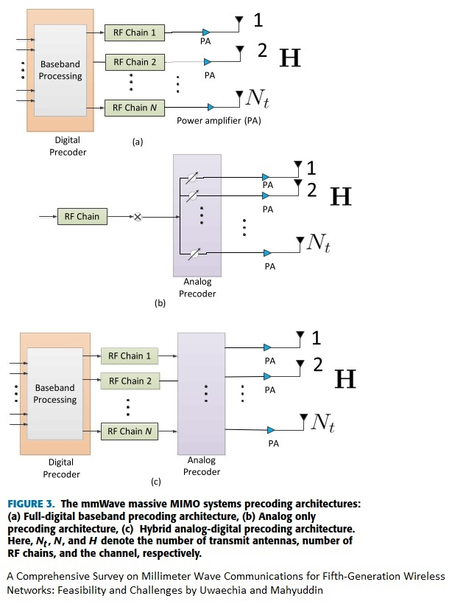
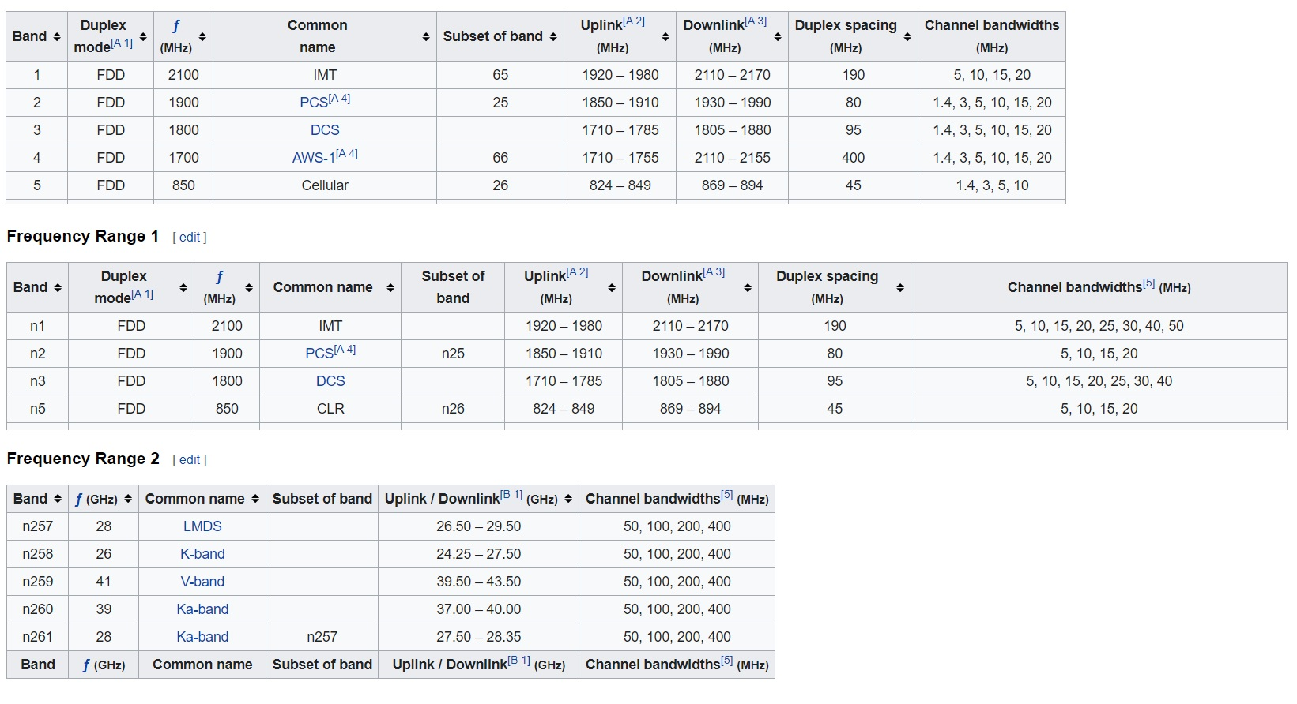
mmWave OVERVIEW
4/5G: 1, 2, 3, 4
Hybrid
4G
5G
©
5G
©
Notes:
Here is a table for 4 and 5G networks
In 5G, we still use the same bands from 4G networks,
There are some new additional bands
The already existing bands are renamed with n and then the band number
So the first two tables are nearly same
But in the last table, we have the additional mmWave frequencies
It is called FR-1 (existing + few more bands), FR-2 mmWave frequencies
These are the band numbers, just n is added
The list is longer of course, I cut a part of it
This column indicates the center frequencies. Here it is MHz and here it is GHz
This column indicates the bandwidths. Both are MHz values but here you see values of 100, 200, and 400, whereas here, you see a maximum value of 50 Hz only
In short, in 5G, we use the existing microwave frequencies from 4G plus the new mmWave frequencies

Slide 16
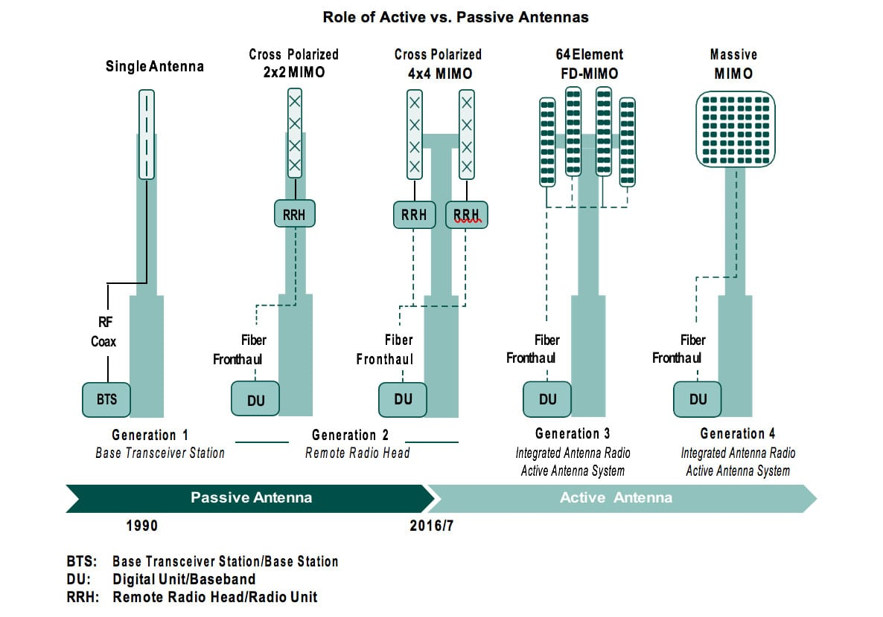
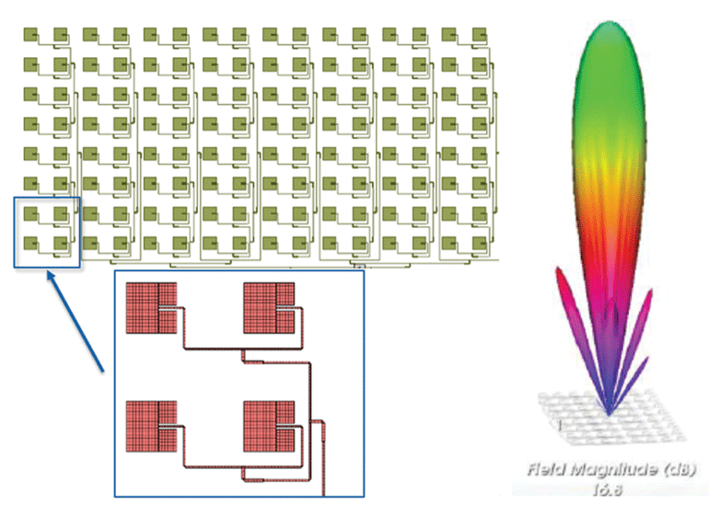
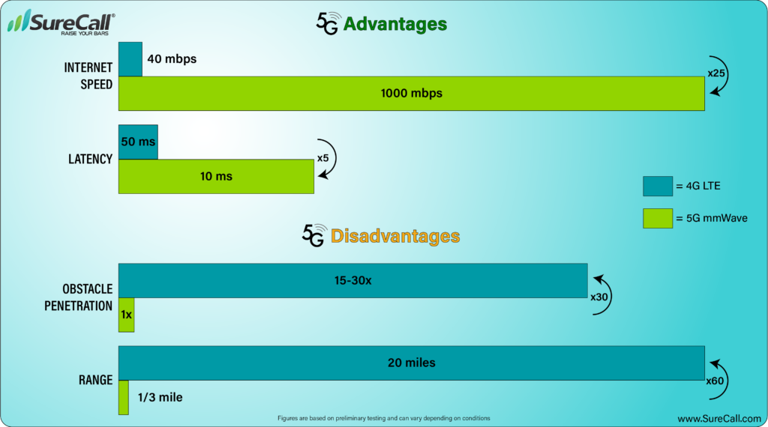
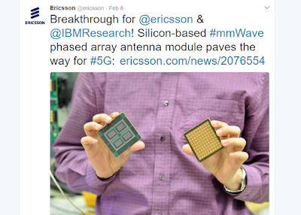
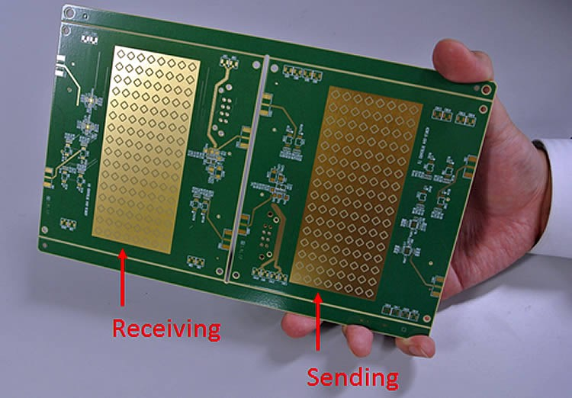
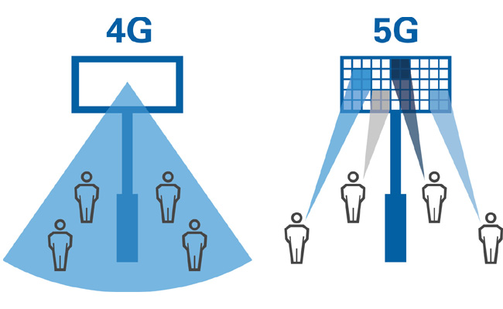
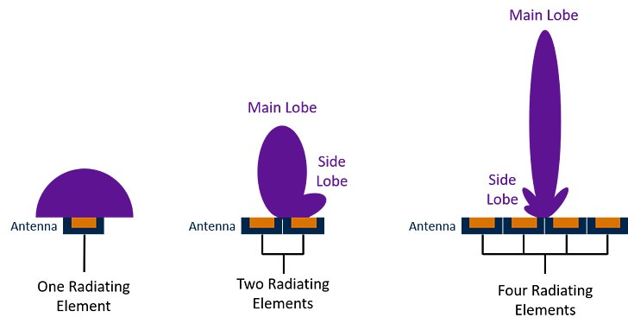
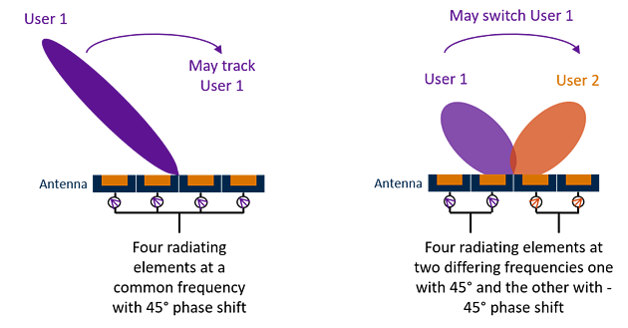
mmWave OVERVIEW
Power and penetration: 1
Very directional: 1 (Page 12, 15), 2 (last figure), 3, 4, 5, 6, 7, 8, 9, 10
©
500 m
20 km
Initial phase:
Indoor: Shopping malls, concert/seminar halls
Outdoor: Stadiums, downtown
Notes:
Here you see speed… comparison of 4 and 5G networks
The speed is high as one of the reasons being said that we have large bandwidths in 5GLatency is also low in 5G networks for which I will give one of the reasons soon
The distance and penetration disadvantages are similar concepts
The range (distance) is low because the signal cannot travel far as I explained
Also, the smaller wavelength means the signal is more susceptible to even rain and fog
Penetrating through the walls is also more difficult
As a remedy to the disadvantages of mmWave signals, the 5G signals will be very directional in contrast to 4G
Assume these are all mmWave signals, if you can make your beam focused rather than wide, you can reach the receiver before your signal fades away (since mmWave signals cannot travel far)
As you see here, this focused signal can reach further
Focusing is achieved by using more antenna elements. (As I said earlier, we can pack more antennas in the same area at mmWave frequencies)
However, being focused brings another disadvantage. For instance, even the slightest movements of our heads become a problem at mmWave because the waves are very directional
So you can track the user by using all these four antennas. Or you can switch to the other beam if the user moves in this direction. Here, the two antennas generate two beams at two different frequencies (not to interference each other)
As you see here, the antennas will be in an array structure. The antenna can be an array of size 64x64, 128x128 etc.
Each of this small circle or rectangle is an antenna
These are the generations of base stations. At 5G, we move to this active antenna era. Here you see a BS with a single antenna, multiple antennas, more multiple antennas, then eventually BSs with many antenna elements in array structures. These both BSs can be called massive MIMO, it is up to you where you draw the line for the number of antennas to be called a massive MIMO system
So, in short, in 4G, waves are wider whereas in 5G, they are very directional
Since 5G signals cannot travel far, the mini-BSs will be everywhere, perhaps every 100, 500 meters, we will have mini-BSs
So this is one reason latency will be low in 5G networks
So in the initial phase, 5G will not be everywhere but in the shopping malls…
So, as a joke, if you plan to commit a criminal activity, you need to think twice this time because they will know your precise location almost : )
Whereas in 4G, they can know your whereabouts. If you are in downtown, it can be more precise, because there are more base stations in downtowns, but in 5G, it can be always precise

Slide 17
5G CONSPIRACIES
Health risks: 1, 2, 3a, 3b, 4
The only documented health risk from mobile radiation is the heating of body tissues. Radiation safety limits are made to prevent this from happening
For most users of 3G and 4G technology, it is easy to stay on the right side of these limits: They are only reached or exceeded if you are directly in front of a base station and less than 10 meters away
Notes:
Thanks to this presentation, I just realized there are amazing conspiracies on 5G networks such as the famous virus can travel on 5G waves as noted on WHOs (world health organization’s) website saying that this is not true
I am not sure about 5G yet, but as you also know, it is good to stay away from 4G BSs
Probably it is the same in Sweden I guess, sometimes telecom operators offer some residential buildings a rental fee in return to put their BSs on top of the buildings. Although the price might be convincing, you really do not want to live on the last two floors of the building
It is the same idea with microwave ovens.
If you put your hand in it, it is no good
If you power it sometimes and try to stay away from it, it is good
But if you power it 24/7 and stay next to it, it is no good at all

Slide 18
WASP – BEAM TRAINING
Team members:
Dr. Cenk M. Yetis - Lund University
Prof. Pontus Giselsson - Lund University
Prof. Emil Björnson - Linköping University (→| KTH)
Proposed a joint analog beam selection and digital beamforming design (1) in millimeter wave (2) cell-free (3) massive MIMO (4) systems
Components (1, 2, and 4) are expected in 5G networks. Cell-free component (3) is a candidate for 6G networks
The complexities of the proposed beam selection algorithms can still be overwhelming in practice
Proposed supervised machine learning (ML) algorithms that can be trained
off-line
62% Matlab, 38% Python with Scikit-Learn (Scikit-MultiLearn)
Notes:
In this work, it was 3 of us.
We proposed a …
Components 1, 2, …
We proposed more advanced nonetheless still simple beam selection algorithms because the complexity can increase very quickly as I said
Even though we propose effective and simpler beam selection algorithms, the complexity can still be high when the network size grows, such as large number of APs, users, antennas, and large number of symbols we want to transmit per user
So we also propose ML algorithms which are trained off-line by our proposed beam selection algorithms

Slide 19
CELLULAR NETWORK vs. CELL–FREE NETWORK
Cell-free networks consist of
many distributed access points (APs) with simple components
that jointly serve the users.
Notes:
Unfortunately, I will skip these slides because there is no time

Slide 20
CHALLENGES
BCC introduces patterns on the decision outputs in the beam selection problems
$B=2$ predefined beams $𝓤=\left\{u_{1},u_{2}\right\}$
$$u_{1}$$
$$u_{2}$$
$$u_{1}$$
$$u_{2}$$
$$u_{1}$$
$$u_{2}$$
$$L=3$$
$$K=2$$

Slide 21
MULTI-LABEL PROBLEMS
Assume $B=6, K=3$. $𝓤=\left\{u_{1},…,u_{6}\right\}$
$L=$4
$T=5$, number of training samples
${DL}_{kl}$: features - direct link powers, $b_{kl}$: labels
Training Samples | $${DL}_{11}$$ | $${DL}_{21}$$ | $${DL}_{31}$$ | $$…$$ | $${DL}_{14}$$ | $${DL}_{24}$$ | $${DL}_{34}$$ | $$b_{11}$$ | $$b_{21}$$ | $$b_{31}$$ | $$b_{12}$$ | $$b_{22}$$ | $$…$$
$$t=1$$ |  |  |  |  |  |  |  | 0 | 5 | 3 | 0 | 5
$$…$$
$$t=5$$ |  |  |  |  |  |  |  | 1 | 6 | 0 | 3 | 2
$$x$$ | $$y_{1}$$ | $$y_{2}$$ | $$y_{3}$$ | $$y_{4}$$ | $$y_{5}$$ | $$…$$
 | 0 | 5 | 3 | 0 | 5
$$…$$
 | 1 | 6 | 0 | 3 | 2
Notation simplification:

Slide 22
MULTI-LABEL PROBLEMS
Binary relevance: $KL$ single label (i.e., multi-class problem) classification problems
Classifier chains: $KL$ single label classification problems
$$x$$ | $$y_{1}$$
 | 0
$$…$$
 | 1
$$x$$ | $$y_{2}$$
 | 5
$$…$$
 | 6
$$x$$ | $$y_{3}$$
 | 3
$$…$$
 | 0
$$x$$ | $$y_{4}$$
 | 0
$$…$$
 | 3
$$x$$ | $$y_{5}$$
 | 5
$$…$$
 | 2
$$…$$
$$x$$ | $$y_{1}$$
 | 0
$$…$$
 | 1
$$[x y_{1}]$$ | $$y_{2}$$
 | 5
$$…$$
 | 6
$$[x y_{1} y_{2}]$$ | $$y_{3}$$
 | 3
$$…$$
 | 0
$$[x y_{1} y_{2} y_{3}]$$ | $$y_{4}$$
 | 0
$$…$$
 | 3
$$[x y_{1} y_{2} y_{3} y_{4}]$$ | $$y_{5}$$
 | 5
$$…$$
 | 2
$$…$$

Slide 23
MULTI-LABEL PROBLEMS
Label Powerset:
$$x$$ | $$y_{1}$$ | $$y_{2}$$ | $$y_{3}$$ | $$y_{4}$$ | $$y_{5}$$ | $$…$$
 | 0 | 5 | 3 | 0 | 5
 | 0 | 5 | 3 | 0 | 5
 | 2 | 1 | 0 | 4 | 3
 | 1 | 6 | 0 | 3 | 2
 | 1 | 6 | 0 | 3 | 2
$$x$$ | $$y_{1}$$ | $$y_{2}$$ | $$y_{3}$$ | $$y_{4}$$ | $$y_{5}$$ | $$…$$
 | 0 | 5 | 3 | 0 | 5
 | 0 | 5 | 3 | 0 | 5
 | 2 | 1 | 0 | 4 | 3
 | 1 | 6 | 0 | 3 | 2
 | 1 | 6 | 0 | 3 | 2
$$…$$
$$x$$ | $$y_{1}$$
 | 0
 | 0
 | 1
 | 2
 | 2

Slide 24
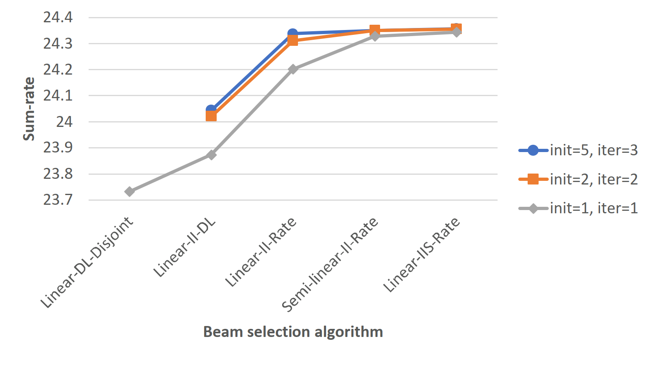
NUMERICAL RESULTS
Sum-rates and simulation durations of selection algorithms
$L3K2M16$ network
init: Number of initializations
iter: Number of iterations
Linear & Direct link power metric (DL)
(Disjoint design. All others are joint designs)
Linear & DL
Linear & Sum-rate metric*
Semi-centralized & Sum-rate
Linear & Sum-rate & Selection
*Sum-rate metric is not noted in the figure for brevity
Notes:
Here you see the sum-rate results and corresponding simulation durations of some advanced beam searching algorithms for some network size
Sum-rates are in b/s/Hz
The lowest sum-rate and the lowest run time here and here belong to that trivial linear search algorithm
If you can consider this grey line only, you can say that you can either choose this or this algorithm
Because there is a substantial increase in the sum-rate with a little increase in the simulation duration for these two algorithms
However, after this point, sum-rate does not advance much while the simulation time starts steeping up
The other two more colourful results are for random number of initializations and iterations
Whereas for the grey plot, the number of initializations and iterations is 1 for each
For the beam searching algorithm, you need to make random beam initializations for all users before the algorithm starts
Random initializations are not needed for the algorithms that use direct link metric but needed for the advanced algorithms
By random initializations, you may find a better point to start with so that perhaps you end up at a better local optimum
The number of iterations equals to 2 for instance means that in the first iteration, you select beams for all APs, but you do one more iteration, and select beams for all APs one more time
The number of initializations and iterations are not helping much to increase the sum-rate because we assume single-antenna users here.
If we assume multiple antenna users, the selection complexity increases a lot suddenly, which may require GPUs rather than CPUs for the simulations. Therefore, in this work, we only investigated only single antenna user cases

Slide 25
NUMERICAL RESULTS
Sum-rates of ML algorithms
Linear-II-Rate algorithm
with init=2 and iter=2 is used
for the training
LSVM: Linear support vector machine
GSVM: Gaussian SVM
MLP: Multi-layer perceptron
$L3K2M8$network
RF & DL: Random forest & Direct link power metric
(All others use sum-rate metrics)
RF (init=1,iter=1): Only for this case
linear-II-Rate algorithm with init=1 and iter=1 is used
for the training
Simulation durations:
RF-01:30, MLP-01:00, GSVM-15:00, and LSVM-00:05 (mm:ss)
Linear-II-Rate-12:00
Notes:
Here we see the sum-rate results of machine learning algorithms
We use normal support vector machines, SVMs with Gaussian kernels, multi-layer perceptron, and random forests algorithms
RF gives the best results
This straight dashed line is the beam selection algorithm that is used to train these ML algorithms
As you see, RF algorithms can achieve sum-rates between 96-99% of the original results

Slide 26
WASP – CHANNEL ESTIMATION
Team members:
Dr. Cenk M. Yetis - Lund University
Prof. Pontus Giselsson - Lund University
Dr. Özlem Tugfe Demir - Linköping University (|→ KTH)
Prof. Emil Björnson - Linköping University (→| KTH)
International Telecommunication Union (ITU) challenge in Artificial Intelligence (AI) and Machine Learning (ML) for 5G networks – ITU AI/ML in 5G Challenge
There are about 40 chapters
International Collegiate Programming Contest (ICPC) challenge
Proposed a sparse channel estimation algorithm to be used for the training of ML algorithms
Proposed expectation maximization (EM) vector approximate message passing (VAMP) application to Bayesian inference framework [Rangan2019]
Matlab object-oriented programming (AMP-Matlab) and TensorFlow (AMP-Deep Learning).
Continued to build on these existing libraries
Notes:
In this work about channel estimation, it was 4 of us
This year, we have noticed that there is a competition organized by a European union called ITU.
It was about AI and ML in 5G networks
You can compete almost about any topic in wireless networks, from coding/decoding, beam selection to channel estimation
I also have noticed there is a competition for ungrad and grad students, if I am not wrong
This competition is live. Teams with 5-6 members sit at a desk with computers, etc. Then they try to solve a given challenging problem in 4-5 hours
In this work, we propose a sparse … Then we again use this algorithm for ML training
We use an existing algorithm called …
We use existing libraries written in Matlab for the estimation algorithm and TensorFlow for the ML algorithm

Slide 27
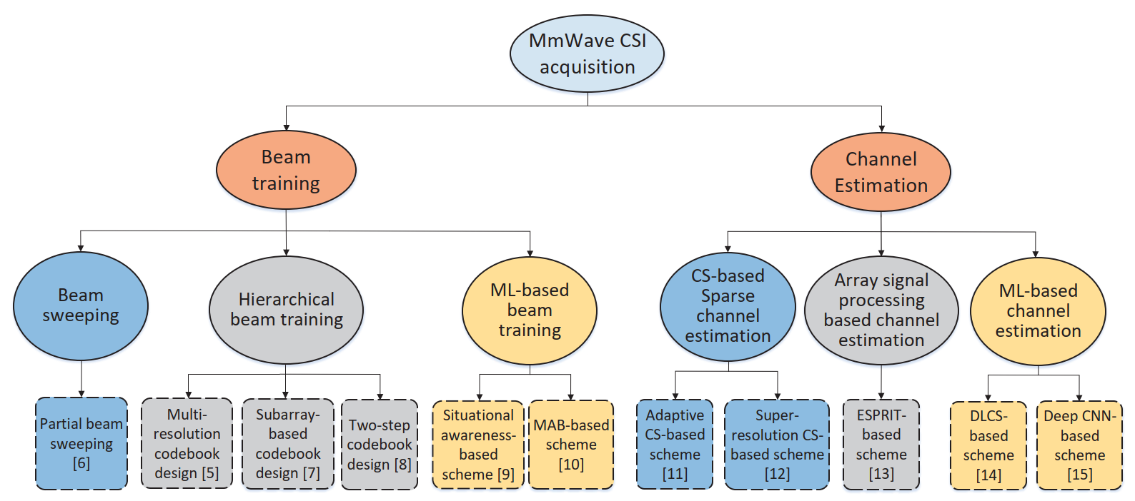
ACQUISITION OF CHANNEL STATE INFORMATION
There are many approaches:
© [Qi2020]
CS: Compressed sensing
Notes:
It is again a mmWave channel
As I mentioned earlier, you can do either beam or channel training
This time we are interested in channel training
Array signal processing means conventional channel estimation algorithms
However, due to the mmWave channel characteristics, compressed sensing (CS) based sparse channel estimation algorithm perform better

Slide 28
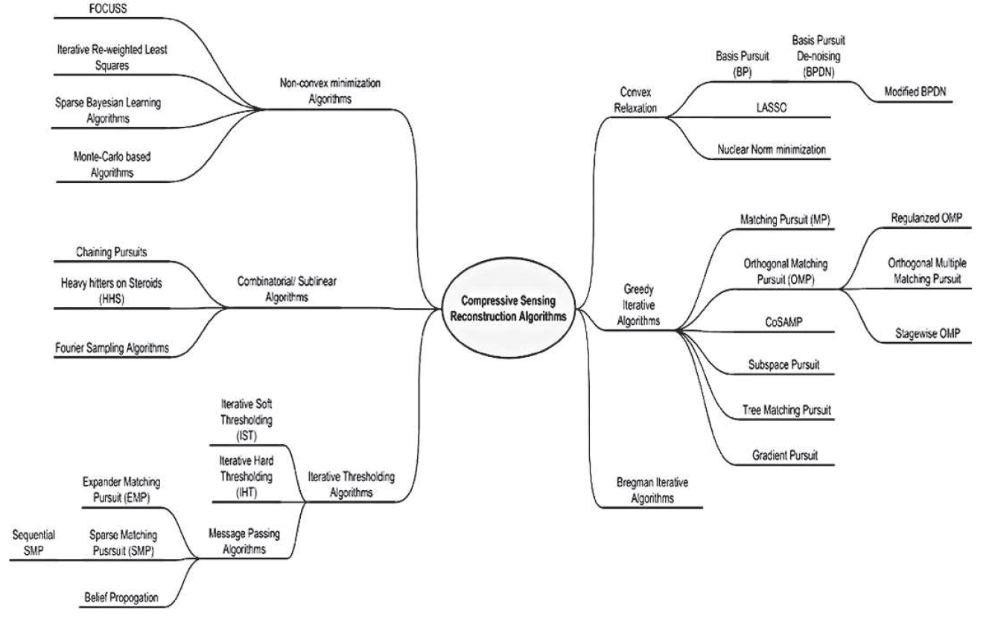
COMPRESSED SENSING BASED
There are many approaches:
© [Qaisar2013]
Notes:
In this figure, CS algorithms are unfolded
In this talk, I will go through greedy iterative algorithms since they are simpler
However, in our work, we use the combination of belief propagation algorithms (also called message passing algorithms) with sparse Bayesian learning algorithms

Slide 29
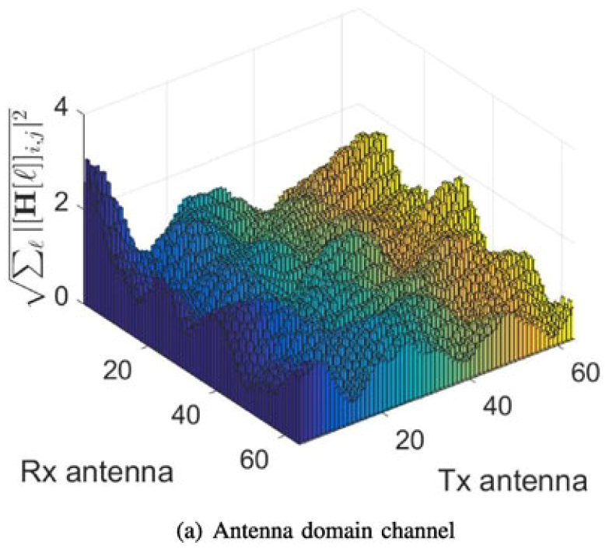
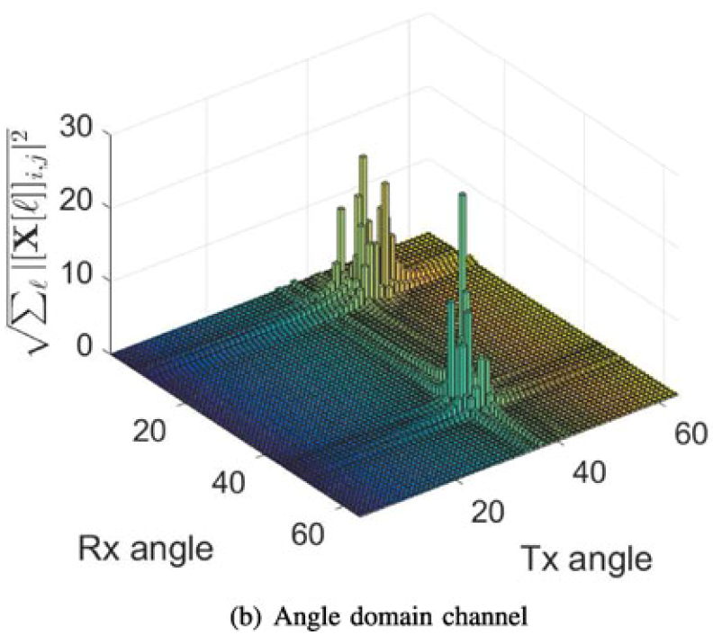
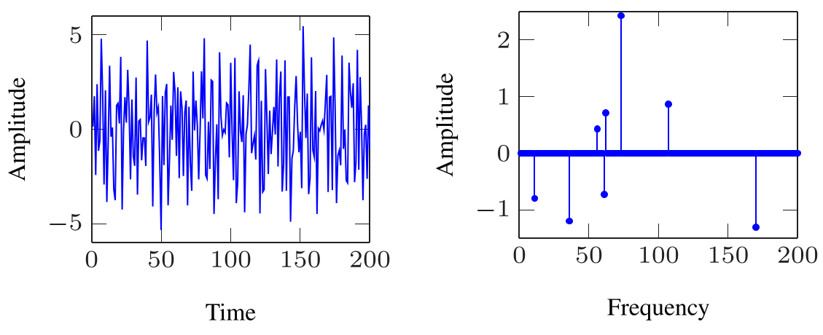
SPARSE CHANNEL ESTIMATION
In mmWave frequencies, the channel H is sparser, i.e., the number of non-zero elements is much smaller than the zero elements in H
Hence, the channel estimation problem can be cast as a sparse signal recovery problem and compressed sensing (CS) techniques can be applied
Sparsity manifests in angle/frequency domain but not in the antenna domain
Sparsity manifests in angle/frequency domain but not in the antenna domain
© [Mo2018]
© [Marques2019]
8 sinusoids in time and frequency domains
Notes:
In mmWave frequencies …
That is, there are more zeros in the H matrix
Hence, the channel estimation … I explain this later
Sparsity manifests in …
Here you see the sum of channel matrix elements. This is called antenna domain because if you remember, we said there a random complex number between each pair of antennas
So, when you move to the angle domain, we can observe the sparsity
As you see here, values are only gather around two areas
The reason for this sparsity is that, at mmWave frequencies, the signals do not scatter much
Scattering means, your signal can multiply while traveling in the air, for instance by bouncing off the walls, desks etc.
Scattering is a good thing actually, not a bad thing because we can benefit from scattering by using multiple antennas
Sparsity can also manifest in frequency domain. Perhaps this is easier to understand.
If you have 8 sinusoidal signals with 200 samples for each, when you take the Fourier transform (FT) of them, you will have only 8 values, and the rest of the 200 values are zero
If you remember, FT of a sinusoidal signal gives you two dirac functions, one at +- frequency value
So as you see here, in general, by moving from one domain to another domain, we can find a sparse representation of a signal.
I said signal but as you know we are interested in channel today. We want to do sparse channel estimation

Slide 30
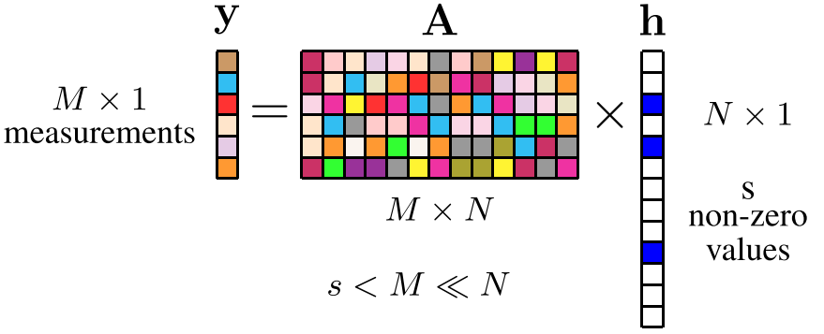
COMPRESSED SENSING
CS steps:
$y=Ax+n$, $y∈ℂ^{M}$: Measurement vector, $A∈ℂ^{M×N}$: Measurement (Sensing) matrix
$x∈ℂ^{N}$: S-sparse signal vector to be recovered, ${\left\|x\right\|}_{0}≤S$
$S≤M≪N$, underdetermined system
1st step, sparse representation
$h=Ψx$, $Ψ$: $N×N$ basis matrix
2nd step, measurement
$φ$: $M×N$ measurement matrix, $y=φh+n=φΨx+n=Ax+n$
$$h$$
$$x$$
© [Marques2019]
$$x$$
© [Marques2019]
Notes:
CS has 3 main steps: Sparse representation (or sparse approximation), CS measurement, and CS reconstruction
I just talked about the sparse representation in the previous slide in general terms
You can also do sparse approximation. If you have a signal vector with values [2.5 3 0.1 0.3 6] for instance, you can just assume those small values 0.1 and 0.3 as zeros. So you approximate the original signal vector [2.5 3 0.1 0.3 6] by a sparse signal [2.5 3 0 0 6]
Now, let’s write y=Ax+n
The maximum number of non-zero elements in x is S
Another assumption is that this is an underdetermined system. That is, M is much smaller than N
Or in other words, the number of observations is much smaller than the length of the signal x to be recovered
Let’s look at the first step, sparse representation
In a sparse representation, the signal is represented as a projection on a suitable basis, i.e., a linear combination of only S basis vectors, with S ≪ N.
In other words, the original signal h (N×1 column vector) can be represented with a basis of N×1 vectors {ψ_i}

Slide 31
COMPRESSED SENSING
CS steps:
$y=Ax+n$, $y∈ℂ^{M}$: Measurement vector, $A∈ℂ^{M×N}$: Measurement (Sensing) matrix
$x∈ℂ^{N}$: S-sparse signal vector to be recovered, ${\left\|x\right\|}_{0}≤S$
$S≤M≪N$, underdetermined system
Remember
$y=Hx+n$
$y∈ℂ^{M},received signal$, $H∈ℂ^{M×N},$ $channel matrix$. $x∈ℂ^{N},transmitted signal$
$$h$$
$$x$$
© [Marques2019]

Slide 32
CHANNEL TRAINING
Training, $t=1,…,T$
$y\left(1\right)=φ\left(1\right)Ψx+n$
…
$y\left(T\right)=φ\left(T\right)Ψx+n$
$TM≪N (Compressed sensing)$
In mmWave channels
$$TL_{r}≪G_{t}G_{r}(Compressed sensing)$$
$L_{r}$: Number of RF chains at the receiver
$G_{t},G_{r}$: Grid sizes at the transmitter and receiver
E.g., $T=20, 40, 80,…$
$L_{r}=4, 8,…$
$G_{t}=64, 128,…$
$G_{r}=64, 128,…$

Slide 33
COMPRESSED SENSING RECOVERY
Basics:
$y=Ax+n$, $y∈ℂ^{M}$: Measurement vector, $A∈ℂ^{M×N}$: Measurement (Sensing) matrix
$x∈ℂ^{N}$: S-sparse signal vector to be recovered, ${\left\|x\right\|}_{0}≤S$
$S≤M≪N$, underdetermined system
Convex Relaxation:
Intuitive solution (assume no noise)
$$\hat{x}=\underset{x}{arg min}{{\left\|x\right\|}_{0}}\text{s}\text{.}\text{t}\text{. }y=Ax (ℓ_{0} minimization)$$
$$\hat{x}=\underset{x}{arg min}{{\left\|x\right\|}_{1}}\text{s}\text{.}\text{t}\text{. }y=Ax (Basis pursuit)$$
In the presence of noise
$$\hat{x}=\underset{x}{arg min}{{\left\|x\right\|}_{1}}\text{s}\text{.}\text{t}\text{. }{\left\|y−Ax\right\|}_{2}≤ℇ,$$
$where ℇ is the upper bound on the noise level$
Unconstrained version
$$\hat{x}=\underset{x}{arg min}{{\left\|y−Ax\right\|}_{2}^{2}+λ{\left\|x\right\|}_{1}}$$
(Basis pursuit denoising-BPDN, or Least Absolution Shrinkage and Selection Operator-LASSO)

Slide 34
ORTHOGONAL MATCHING PURSUIT (OMP)
Consider the $i^{th}$ iteration
Step 1: Initialize $v_{0}=y$ (residual is initialized to the received vector)
Step 2: Find the column index $n$ that is maximally correlated with the residual (modified observation)
$$\max_{n}{a_{n}^{H}v_{i−1}}$$
Step 3: Update the submatrix $A_{i}=\left[a_{1}… a_{t}…a_{i}\right]$, where $a_{t}$ is the column vector of $A$ chosen (via step 2) at iteration $t$, i.e., stack the columns selected at each iterations into the submatrix
Step 4: Estimate ${\hat{x}}_{i}=A_{i}^{H}y$ and update $v_{i}=y−{\hat{y}}_{i}$, where ${\hat{y}}_{i}=A_{i}{\hat{x}}_{i}$
Step 5: Iterate until e.g., $\left\|v_{i}\right\|≤ε$
By removing the contribution of ${\hat{x}}_{i}$ from the observation vector $y$, the identiﬁcation of the remaining nonzero elements is targeted in the next iteration

Slide 35
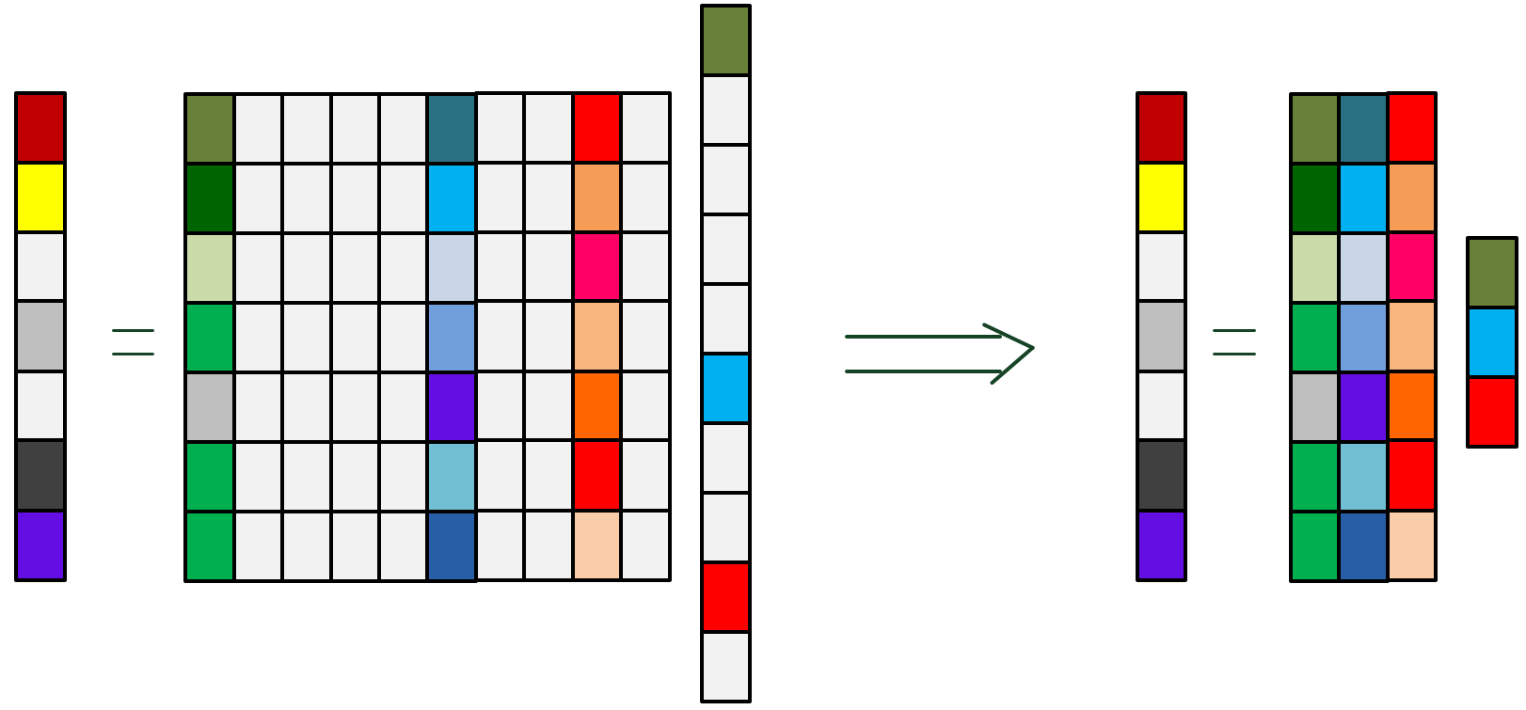
ORTHOGONAL MATCHING PURSUIT (OMP)
© [Choi2017]
By choosing the right columns, underdetermined system can be converted into an overdetermined system

Slide 36
ITERATIVE ALGORITHMS – ISTA and AMP
Iterative shrinkage/threshold algorithm (ISTA)
$v_{i}=y−{\hat{y}}_{i}$, where ${\hat{y}}_{i}=A{\hat{x}}_{i}$
$${\hat{x}}_{i+1}=η\left({\hat{x}}_{i}+A^{H}v_{i};σ\right)$$
$η\left(r;σ\right):ℂ^{N}→ℂ^{N}$ shrinkage/thresholding operator applied to each element of the input vector $r$
E.g., soft thresholding
$η_{n}\left(r;λ\right)=sgn\left(r_{n}\right)max\left(\left|r_{n}\right|−σ,0\right)$, where $x_{n}$ is the $n^{th}$ element of vector $x$
Approximate message passing (AMP)
$$v_{i}=y−A{\hat{x}}_{i}+b_{i}v_{i−1}$$
$${\hat{x}}_{i+1}=η\left({\hat{x}}_{i}+A^{H}v_{i};σ_{i}\right), where$$
$b_{i}=\frac{1}{M}{\left\|{\hat{x}}_{i}\right\|}_{0}$ and $σ_{i}=\frac{α}{\sqrt{M}}{\left\|v_{i}\right\|}_{2}$
$α$: tuning parameter
Onsager correction term

Slide 37
APPROXIMATE MESSAGE PASSING (AMP)
AMP for any Lipschitz-continuous shrinkage function:
$$v_{i}=y−A{\hat{x}}_{i}+b_{i}v_{i−1}$$
$${\hat{x}}_{i+1}=η\left(r_{i};σ_{i}\right), where r_{i}={\hat{x}}_{i}+A^{H}v_{i}$$
$b_{i+1}=\frac{1}{M}\sum_{n=1}^{N}{\frac{∂η\left(r_{i};σ_{i}\right)}{∂r_{i,n}}}=\frac{N}{M}\left\langle η^{′}(r_{i};λ_{i})\right\rangle =\frac{N}{M}\left\langle divη(r_{i};λ_{i})\right\rangle$and $σ_{i}=\frac{1}{\sqrt{M}}{\left\|v_{i}\right\|}_{2}$
$η^{′}\left(.\right)$: derivative of $η\left(.\right)$, $\left\langle .\right\rangle$: average of a vector, $r_{in}$: $n^{th}$ element of vector $r_{i}$, and div is the divergence operator
$η^{′}\left(r_{i};λ_{i}\right)=\frac{∂η\left(r_{i};σ_{i}\right)}{∂r_{i,∀n}}=divη(r_{i};λ_{i})$ are different use cases in the literature
When $A$ a is large i.i.d. sub-Gaussian matrix $r_{i}={\hat{x}}_{i}+A^{H}v_{i}$ can be modelled as $r_{i}=x_{0}+𝒞𝒩\left(0,σ_{i}^{2}I_{N}\right)$, where $x_{0}$ is the true signal
Observed by numerical evidences that Onsager correction assures this approximation

Slide 38
APPLICATION OF AMP TO BAYESIAN INFERENCE FRAMEWORK
Another approach for solving
$$\hat{x}=\underset{x}{arg min}{{\left\|y−Ax\right\|}_{2}^{2}+λ{\left\|x\right\|}_{1}}$$
is the Bayesian framework. In a Bayesian framework, prior density $p\left(x\right)$ and likelihood function $p\left(y|x\right)$ is assumed on $x$, to evaluate the following posterior density
$$p\left(x|y\right)=\frac{p\left(y|x\right)p\left(x\right)}{\int{p\left(y|x\right)p\left(x\right)dx}}$$
Then, the posterior density can be used to evaluate the MMSE estimate
$$\hat{x}=\underset{\tilde{x}}{arg min}{\int{{\left\|x−\tilde{x}\right\|}_{2}^{2}}}p\left(x|y\right)dx=E\left[x|y\right],$$
where $E[.]$ is the expectation operator
Instead of the notation $η\left(r;σ\right)$ for the denoiser function, let us use the $g\left(r,υ\right)$ notation where $υ=\frac{1}{σ}$ is the precision of the noise

Slide 39
APPLICATION OF AMP TO BAYESIAN INFERENCE FRAMEWORK
Assume i.i.d. prior
$$p\left(x\right)=\prod_{n=1}^{N}{p\left(x_{n}\right)}$$
AMP can be applied to the MMSE problem of Bayesian framework by choosing the denoiser as
$g\left(r_{n},υ\right)=E\left[x_{n}|r_{n},υ\right]$ (Iteration index $i$ is dropped)
Derivative of the above scalar MMSE denoiser is given as
$g^{′}\left(r_{n},υ\right)=υvar\left[x_{n}|r_{n},υ\right]$,
where $var[.]$ is the variance operator
AMP can diverge when the measurement matrix $A$ is even mildly ill-conditioned or has nonzero mean
Vector approximate message passing (VAMP) is much more robust than AMP, i.e., when $A$ is even highly ill-conditioned or has nonzero mean
Explaining further intuitions behind VAMP and Bayesian inference require significantly more slides and time. Covering these topics in another presentation is more feasible

Slide 40
NUMERICAL RESULTS
In progress
Currently, further improvement of the normalized mean squared error (NMSE) of the channel estimate is being focused

Slide 41
REFERENCES
[Choi2017] J. W. Choi, B. Shim, Y. Ding, B. Rao, and D. I. Kim, “Compressed sensing for wireless communications: Useful tips and tricks,” IEEE Commun. Surv. Tutorials, 2017.
[Marques2019] E. C. Marques, N. Maciel, L. Naviner, H. Cai, and J. Yang, “A review of sparse recovery algorithms,” in IEEE Access, 2019.
[Mo2018] J. Mo, P. Schniter, and R. W. Heath, “Channel estimation in broadband millimeter wave MIMO systems with few-bit ADCs,” in IEEE Trans. Signal Process., 2018.
[Qaisar2013] S. Qaisar, R. M. Bilal, W. Iqbal, M. Naureen, and S. Lee, “Compressive sensing: From theory to applications, a survey,” in J. Commun. Networks, 2013.
[Qi2020] C. Qi, P. Dong, W. Ma, H. Zhang, Z. Zhang, and G. Y. Li, “Acquisition of channel state information for mmWave massive MIMO: Traditional and machine learning-based approaches,” June 2020. [Online]. Available: http://arxiv.org/abs/2006.08894.
[Rangan2019] S. Rangan, P. Schniter, and A. K. Fletcher, “Vector approximate message passing,” IEEE Trans. Inf. Theory, 2019.

